Slide 1

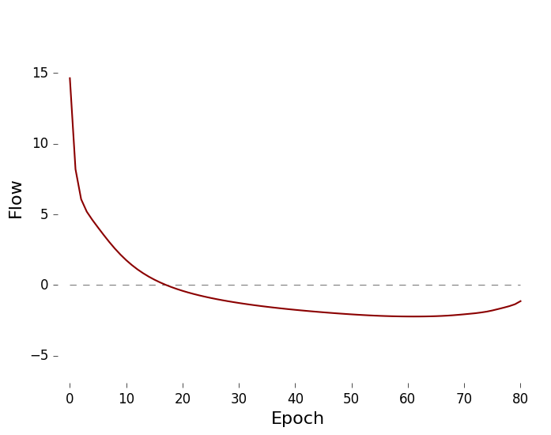
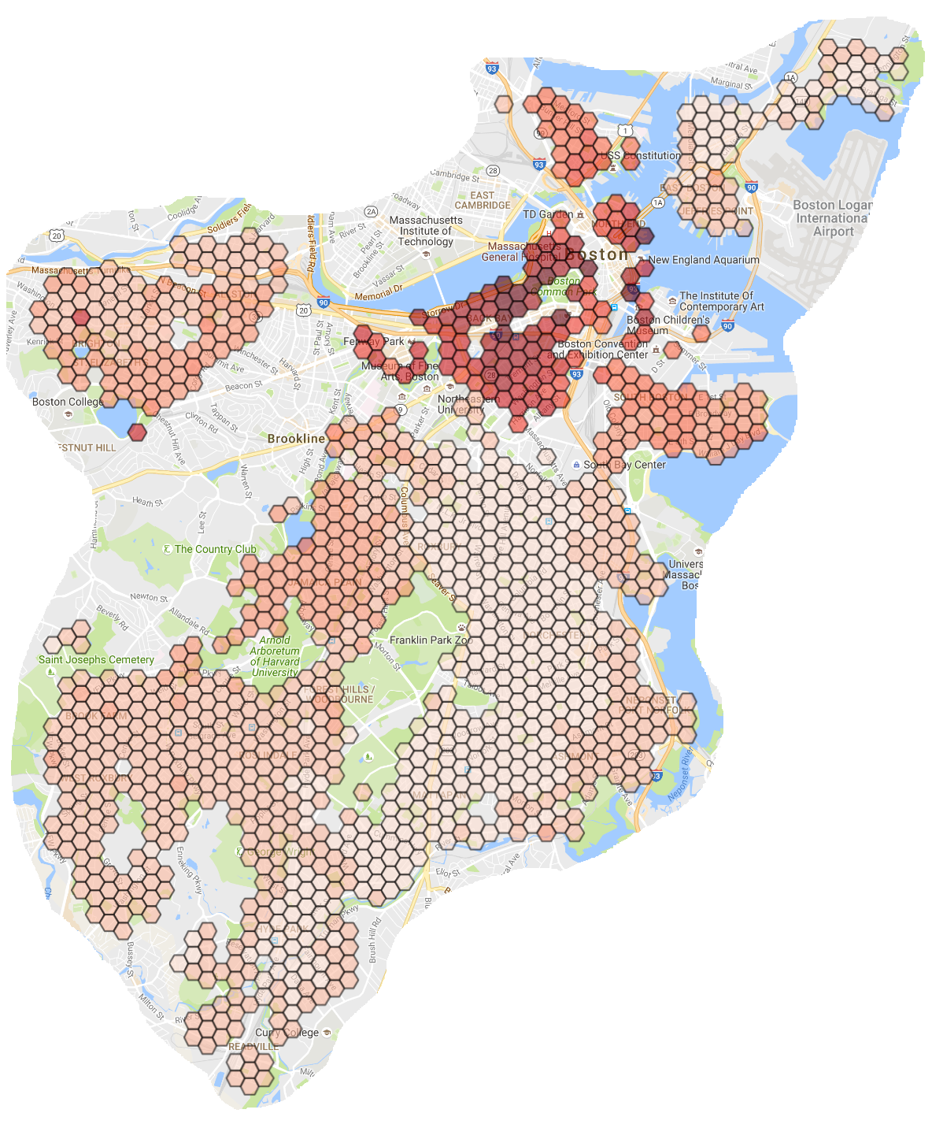
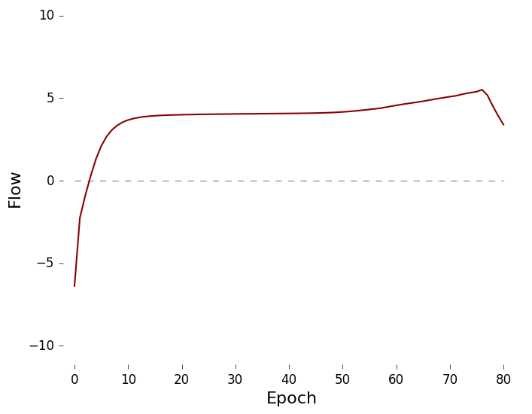
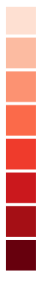
Topographical Modeling of the Boston Housing Market
Graph Transformation
A study by Daren McCulley for CS 591B – Networks and Markets
2016 cell map depicted as a choropleth
overlaying the city of Boston as well as flow diagrams for two of the cells
Transformation to a graph was necessary for implementing the flow algorithm, which provides a way to characterize nodes based on their relative position in the network.
Governments charged with managing urban development have an increasing supply of data available to draw upon for making informed decisions about how to deal with the challenges they face. One of those challenges is providing affordable housing options for residents of all income levels. This study considered Boston’s housing market from 1985 to 2016 – specifically historical assessment data on over 120,000 residential properties. Research on housing typically incorporates multiple data sources, variables, and controls in an effort to build a complex model suited to a complex problem. By contrast, this study relied on a single dataset, which the city of Boston produces annually with a vested interest in its accuracy. Raw historical assessment data was distilled into a graph modeling the distribution of property value throughout the city for each year with the aim of predicting future value based on present day attributes. A precipitous rise in value might price out a large percentage of the city’s labor force responsible for its daily operation and viability.
An algorithm for generating
weak edges allows interaction
between disconnected components.
Data & Methods
Subdivided Boston into thousands of small hexagonal cells through a process known as tessellation.
Collected, filtered, and assigned residential parcels to host cells via the data processing method depicted below.
Transformed cell map into a graph as described in the upper right panel.
Trained a support vector machine (SVM) classifier using static features (e.g. living area) along with dynamic features (e.g. flow), produced by the algorithm described in the bottom right panel.
value / sq-ft
> $97
> $197
> $297
> $397
> $497
> $597
> $697
> $797
Strong Edge
Weak Edge
Assessment Data
Source: www.cityofboston.gov/assessing/search/
π}
Analysis & Results
Flow Algorithm
retained type; address; living area; assessed values
Static Cell Features
parcel count | not selected
total living area | not selected
avg assessed value | not selected
strong edge count | not selected
weak edge count | selected
rank | selected
Dynamic Cell Features
max flow | selected
min flow | not selected
initial flow | selected
early flow | selected
middle flow | not selected
late flow | selected
net flow | not selected
outflow | selected
inflow | selected
absolute flow | not selected
total flushed | selected
flush ratio * | not selected
Machine Learning
Ranked cells by value to gauge performance relative to the market
Trained SVM on ’86 data and observed rank in ’01
Used SVM on ’01 data to predict positives in ’16
Single Cell Predictions
σ}
Approach | # Selected | True Positives (54 possible) | Avg Δ-Rank of Selected
Topographical | 28 | 10 | 193.18
Positive ’01 | 32 | 2 | 141.66
Static Only | 10 | 2 | 146.81
Parameters
k_{s} – strong resistance
k_{w} – weak resistance
k_{f} – flush constant
/* PSEUDO-CODE */
epoch = 0
total = sum([node.value for node in nodes])
while total > stop_threshold:
// 1) compute flow
for node in nodes:
for neighbor in node.neighbors:
compute node.outflow.neighbor
// 2) emit flow
for node in nodes:
for neighbor in node.outflow:
node.value –= node.outflow.neighbor
neighbor.value += node.outflow.neighbor
// 3) flush
for node in nodes:
node.value –= node.flush
total -= node.flush
epoch += 1
selected condos; small apartment buildings; one, two, and three-family homes
π}
d
adjusted valuations for inflation
Topographical – this study’s approach, leveraging flow characteristics
Positive ‘01 – sticking with the best performing cells in the training data (’86 – ’01)
Static Only – using only features available without building the graph (e.g. rank)
f_{ab} = k_{s}(v_{a} - v_{b})
f_{bd} ≈ 0
σ}
b
f_{cd} = k_{w}(v_{c} - v_{d})
removed all outliers
Positive Observations
Any cell which jumped at least 25 percentiles (278 ranks in the test set)
# of training set pos: 34
# of test set pos: 54
Expanded Predictions
a
π}
Approach | # Selected | True Positives (54 possible) | Avg Δ-Rank of Selected
Topographical-1 | 131 | 32 | 140.91
Positive ’01-1 | 90 | 10 | 124.08
Topographical-2 | 255 | 48 | 109.57
Positive ’01-2 | 141 | 17 | 112.01
Best Range 255 | 255 | 40 | 31.19
c
attributed a cell-id to each parcel
Flow is linearly proportional to
the difference in value between
connected nodes.
Flush is linearly proportional to total living area (i.e. capacity).
parcels were sorted into cells via MongoDB’s geoWithin
The ten true positives selected by the SVM gained an alarming 410.7 ranks on average between ’01 to ’16.
An expansion of the single-cell predictions to include their neighbors.
‘-1’ & ‘-2’ are expansions to include all cells within a radius of 1 or 2 respectively. Best Range 255 selects the range of 255 cells from the rank-ordered list that produces the max # of positives for a 1-to-1 comparison with Topographical-2.
*total flushed / avg assessed value (hybrid feature)

